Slide 1
LECTURE - 4
AVERAGE- TRICKS & TIPS

Slide 2
Contains:
Average calculations
Inclusion and exclusion(replacement problems)
Weighted average

Slide 3
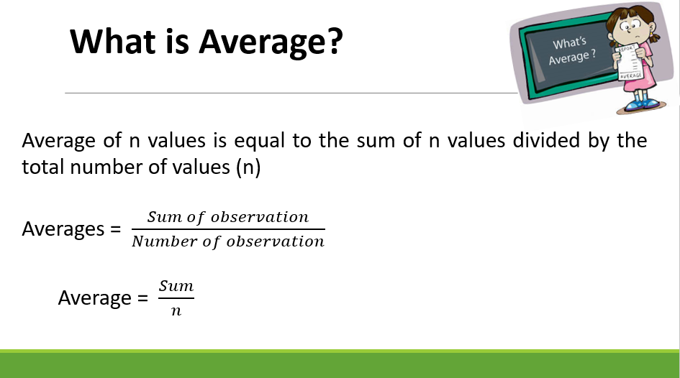

Slide 4
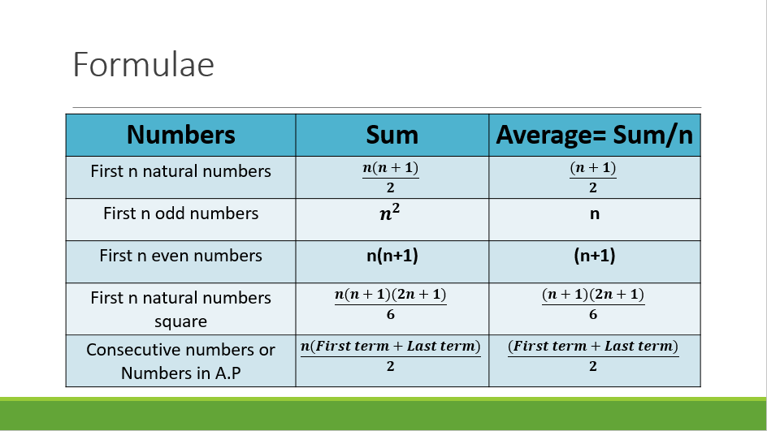

Slide 5
Average if terms are in A.P or consecutives
If the terms are consecutives or are in A.P then average is always the middle term

Slide 6
Question : Find the average of all even numbers up to 100.
50
51
52
55

Slide 7
Question : Find the average of 13, 16, 19, 22, 25, 28
22
19
19.5
20.5

Slide 8
Question : If the average of 5 consecutive number is 21. Find the largest number.
22
23
24
25

Slide 9
Question : If the average of 5 consecutive odd number is 25, then find the smallest number.
(a) 23 (b) 21 (c) 29 (d) 19

Slide 10
Question : Find the average of first 100 natural numbers.
50
50.5
51
49

Slide 11
Question : Find the average of first 100 whole numbers.
50
50.5
49.5
49

Slide 12
Question : The average of first 10 even numbers is?
18
22
9
11

Slide 13
Question : Find the average of first 17 multiples of 5?
50
85
45
60

Slide 14
INCLUSION AND EXCLUSION

Slide 15
Question : The average age of a committee of 12 members is 48 Years. A member of age 62 retired and in place a new person aged 26 joined the committee. Find the new average of the committee.
44
45
46
47

Slide 16
Question : The average age of 10 members in a committee is increased by 3 years when two men whose ages are 25 years and 35 years are replaced by two new men. Find the average age of two new men.
40
45
48
52

Slide 17
Question: If A batsman score 36 runs in his 18th innings so that his average is reduced by 3 run. Find the average of batsman in 18th inning.
(a) 90
(b) 85
(c) 87
(d) None

Slide 18
Question: A baller whose balling average is 12.4 runs/wicket. He played his next match and takes 5 wickets for 26 runs; therefore, his average is reduced by 0.4. Find the total number of wickets taken by the baller.
(a) 80
(b) 85
(c) 90
(d) 75

Slide 19
WEIGHTED AVERAGE
Class A
0
Class B
100
What is the combined average?
50 marks??
NO
We cannot determine the average without knowing the number of students in each class
The combined average depends on the number of students and the average in each class

Slide 20
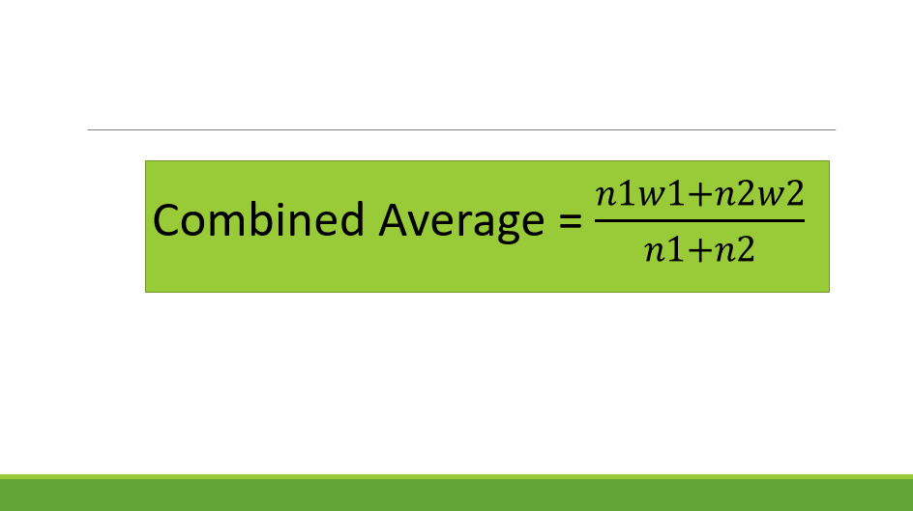

Slide 21
Question : There are 36 students in a class A whose average weight is 30kg and 24 students in class B whose average is 40kg. What will be the average if the classes are combined?
35
34
36
32

Slide 22
Question : There are 63 students in a class A whose average weight is 32kg and 21 students in class B whose average is 44kg. What will be the average if the classes are combined??
33
35
36
38

Slide 23
Question : In a class there are 20 boys and 40 girls. The average age of boys is 18 years and that of girls is 15 years. What will be the average age of the whole class?
16.5 Years
17 years
16 years
14.2 Years

Slide 24
Question : The average of marks obtained by 120 candidates was 35. If the average of passed candidate was 39 and that of failed candidate was 15, the number of candidates who passed the examination is?
100
110
120
150

Slide 25
Question : A teacher while calculating the average marks of 30 students of an examination, by mistake enter a student’s marks as 68, instead of 86 and obtained the average as 58. Find the actual average.
59
60
58.6
60.5

Slide 26
Question : A Student’s marks were wrongly entered as 83 instead of 63. Due to that the average marks of the class got increased by 2. The number of students in class is?
10
12
15
18

Slide 27


